Slide 1
Microservices Enabling Digital Experiences and Aggressive Go to Market
Jan 15, 2020

Slide 2
Monolithic approach
Processes had become tightly coupled in the system, even long after the relationship had ceased
(e.g. credit check, supply chain/billing/activation)
Simple updates to offerings came to require extensive time to assess the impacts and implement the solution
(costs followed the increasing time to market)
Order Negotiation
Order Fulfillment
Activation

Slide 3
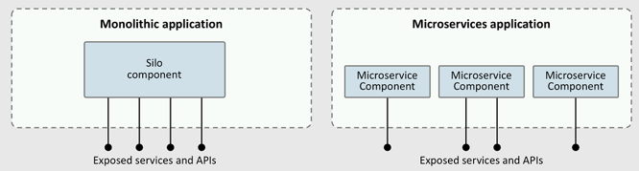

Slide 4
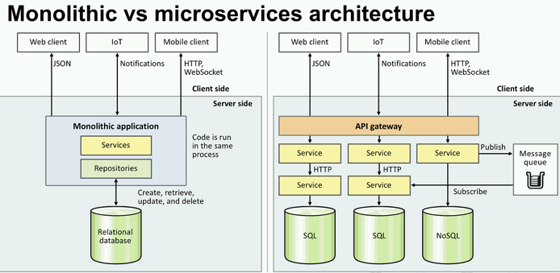

Slide 5



Various possible implementations : View 2
Interface
Program will be responsible for building Billing API in Apigee and Billing capability APIs
API Gateway
Mediation
Threat & Security Policies
Traffic Control
Analytics
Caching
Experience µService / Cloud Native Apps
Capability µService / Cloud Native Apps
FA
AutoPay
Contract
Paperless bill
Quotation
Usage
balance
DEEP.io

Slide 6
The Solution: Architecture and Technology
Simplify the integration architecture to decouple systems and processes and extend the integration architecture to include event based processing
Microservices
Eventing
Eventual Consistency
Adopt a microservices architecture to decouple long running orchestrated integrations
Adopt event based processing to coordinate processing without creating artificial process serialization and dependencies
Adopt an appropriate balance between real time resiliency and eventual consistency in data
Order Negotiation
MS-1 generates an event
MS-3 defers processing the event in support of eventual consistency
MS-1 generates an event
MS-2 retrieves the event for additional processing
Event manager
Event manager
MS-1
MS-3
MS-1
DB
MS-1
MS-2
MS-3
DB
The composite integration (including orchestration) is decomposed into a set of independent microservices
DB
DB
DB
SoR
MS-2
MS-2
Activation
DB
MS-2 retrieves the event and processes it immediately to support real-time resilience
Each microservice operates with a specific Bounded Context

Slide 7
A Practical Example: Promotion Decision Engine
The Solution At a Glance
Technology and Architecture in Action
Systems of Engagement
(SoE)
Microservices
Support the messaging layer for both direct (real-time) and event based requests
Support the action layer for processing and actioning requests
Eventing
Supports more than 40 event types from common user events
Support actioning with Systems of Record (SoR)
Eventual Consistency
Consumer notified of offer/confirmation immediately
SoRs updated in best effort
Retail
Care
Self
Mobile
Fixed
Promotion Decision Engine
Event Manager
Data Grid
Data Grid
SoR
Registration
Notification

Slide 8
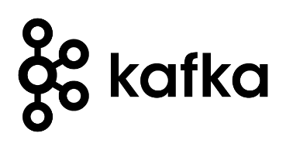
Kafka as a large Q for Microservice
REST
Consumers
API Gateway
Broker 1 (aws_ap1:9092)
Topic→ Customer
C1
Messages to be retained for 15 min
10.88.169.189
Kafka
Connector
Microservice 1
P0
Producers
1 Partition , 1 Replication (acks=0)
Group 1
Topic→ Asset
C2:1
131.116.182.31
Messages to be retained for 30 min
P0
C2:2
P1
10.88.169.189
2 Partition , 1 Replication acks=0
Broker 2 (aws_ap2:9092)

Slide 9
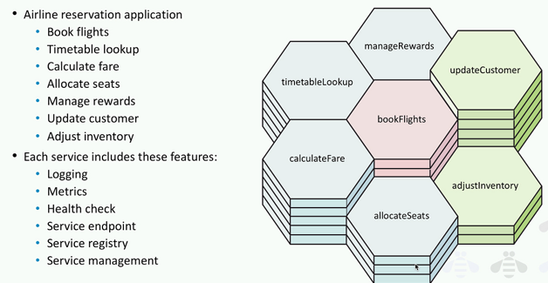
Kubernetes
How will the Docker containers talk to each other?
How will the containers scale with increased demand?
What happens when a container fails?
How will load balancing work between containers?
Docker
Continuous deployment and testing – Docker ensures consistent environments from development to production
Portability – Containers can be run in all major Cloud platforms
Version control – Docker allows you to commit changes to your Docker images with version control, making it easy to roll back to previous versions
Isolation – Docker ensures each container has its own resources isolated from other containers
Security – Isolation ensures that no container can look into processes running inside another container. Therefore, if one container is hacked, others can’t be affected.

Slide 10








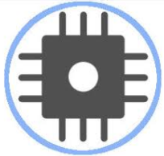


Sample Business Process (B2B : New Customer & Subscription)
Traditional
Emerging (/aaaS)
Conversational UI
Messaging
Platforms
Kiosk
Wearable technology
Developer network
IoT Enabled
Identity and Access Management : Guest, Customer, Device & User
Marketing
Sales enabler
CPQ
Care
Portals / Mobile Apps
Automation and Intelligence
API Gateway
Contact, Lead
Sales Catalog Mgmt
Customer Interface
Customer Interface
Campaign Management
Qualification
Quote
Quote Document
Customer Interaction
Customer Interaction
Changing - Differentiation
Marketing Automation
Prospect
Approvals
Bill inquiry handling
Bill inquiry handling
Opportunity
Issue & Track Order
Order Capture
Common Information Layer
Customer information
Product Information
Asset Information
Case information
Micro-Services Via API gateway
Cloud Integration Platform
Digital Microservice Platform
Enterprise Applications
Order Management Services
Charging and Billing Services
Policy Charging Rules & Enforcement (PCxF)
Legacy Applications
Standard – commodity
Custom Adaptors
Pre built Adaptors
Service bus
OSS
Activation
Inventory
Network

Slide 11

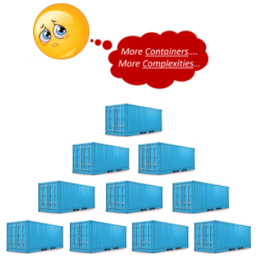
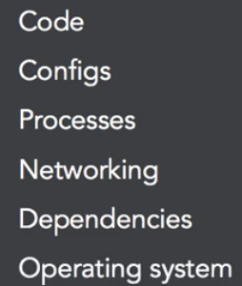
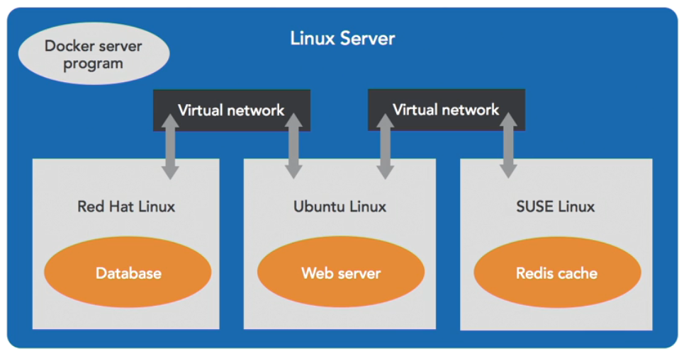

Docker
Docker is not Virtual machine
Docker Containers
Portable
OS
Docker Cloud

Slide 12
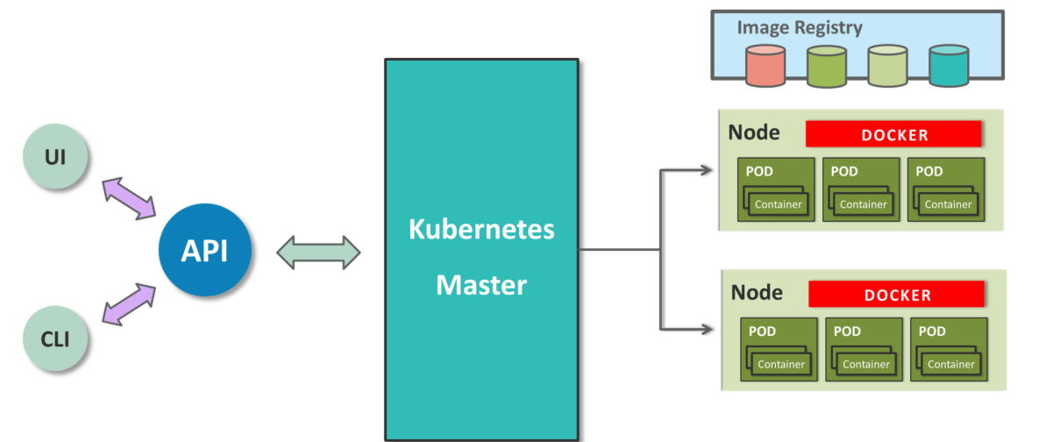
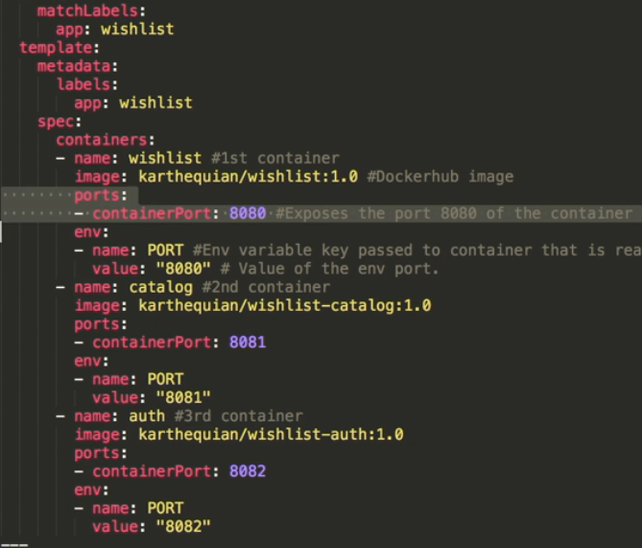
Kubernetes
Server Farm (Inside Data center)

Slide 13
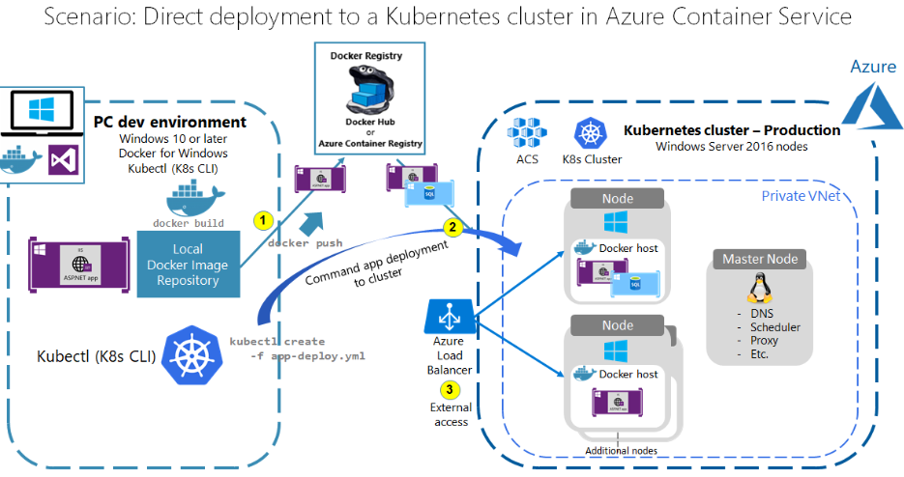

Slide 14
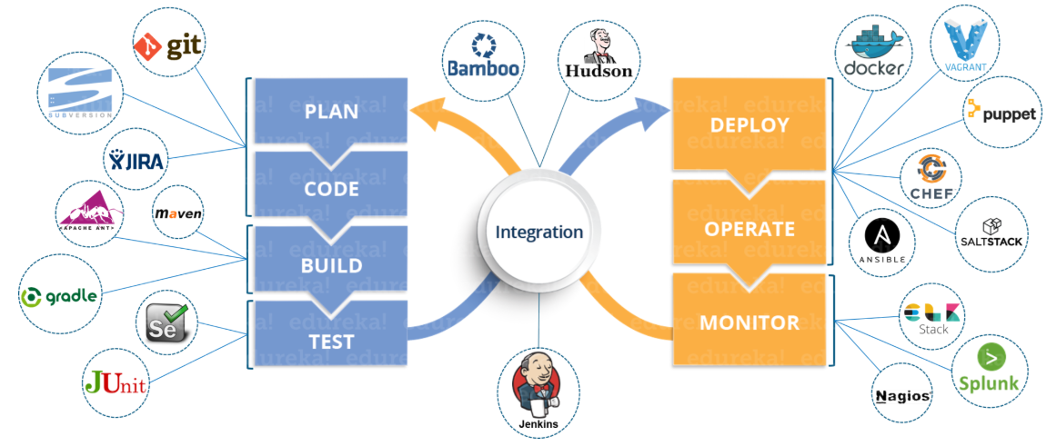
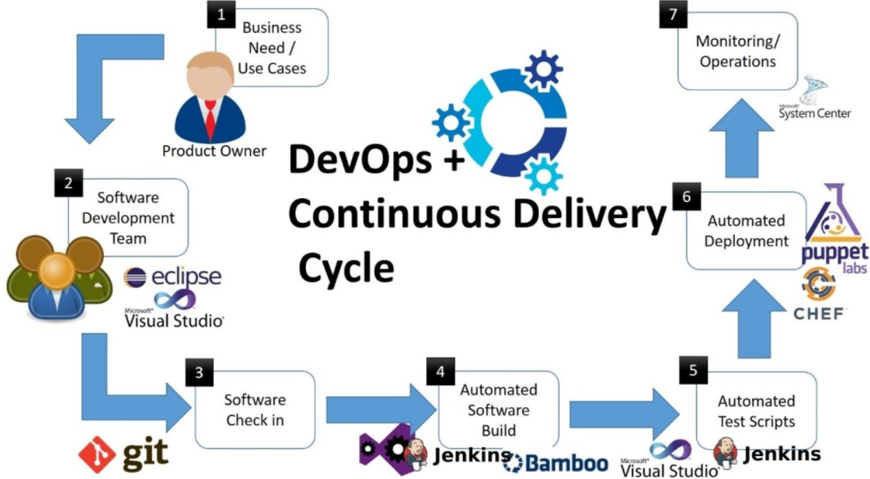
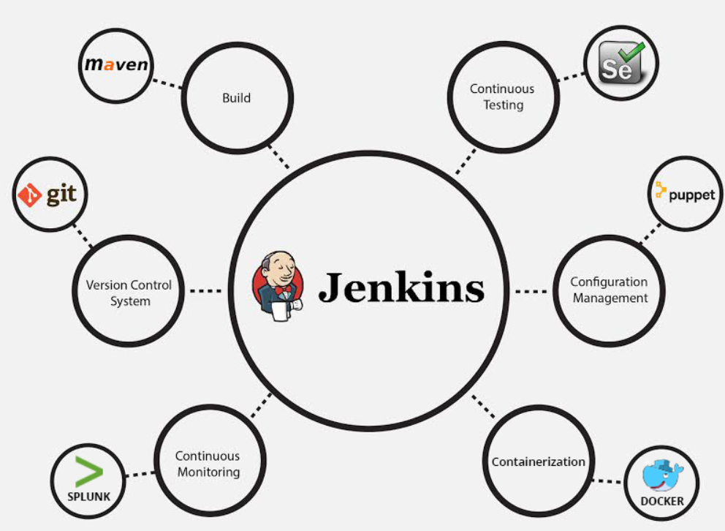
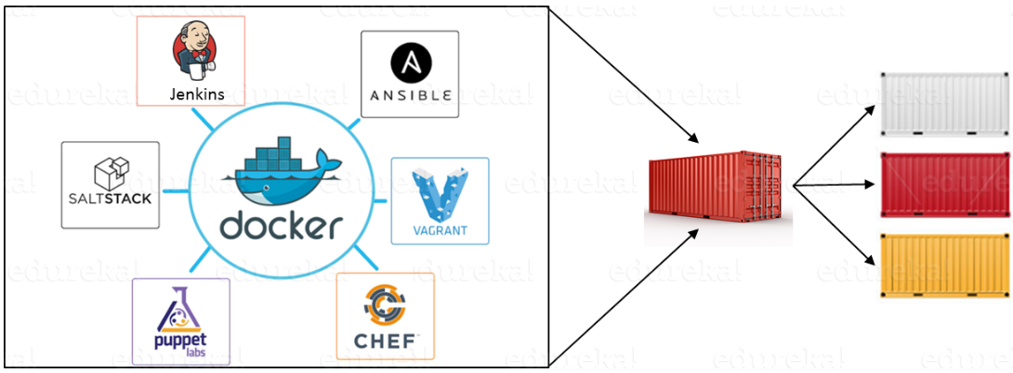
DevOps CI and CD

Slide 15
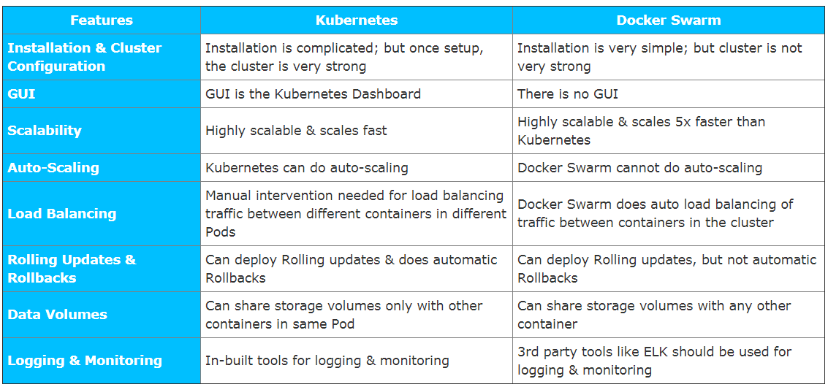
Is Kubernetes only option for container orchestration ?

